Slide 1

Rise & Fall of Big Data hype
Dinesh Kumar P
“Without data you are just another person with opinion”
- W. Edwards Deming.

Slide 2
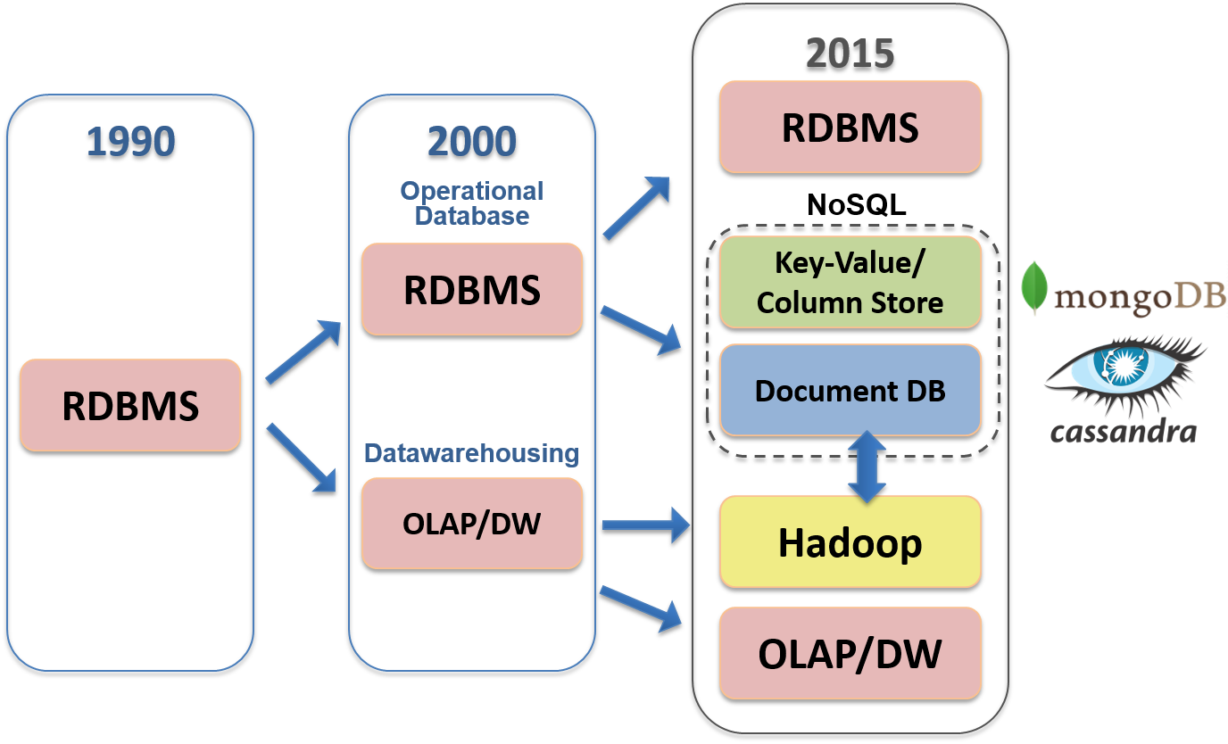

Slide 3
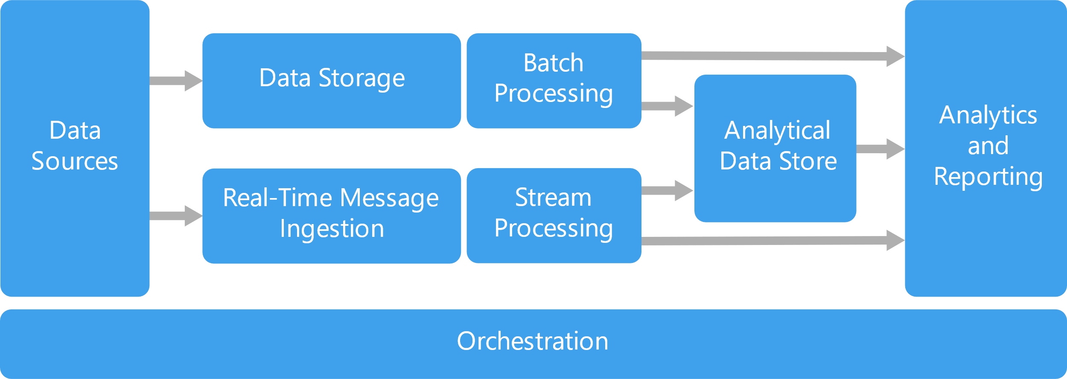

Slide 4
Big Data Hype
Companies were selling Big Data solutions as a silver bullet solution to all the enterprises’ problems.
Use case using Hive+Oozie turned with MySQL+Cron.
There was no ideal approach like below;
Client - “I want to implement a Big Data solution”
Consultant- “That could be the solution, but let us discuss the problem first”.
Notes:
My opinion - Ecosystem projects are not growing to be compatible with Hadoop. E.g. Pig, Sqoop, Oozie,…

Slide 5
Kafka and Spark
Streaming platform’s necessity.
Hadoop made fast.

Slide 6
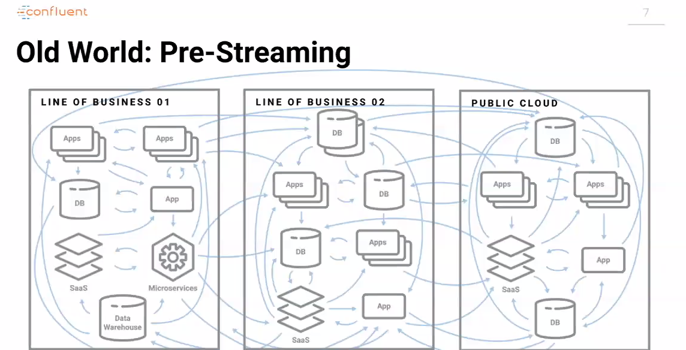

Slide 7
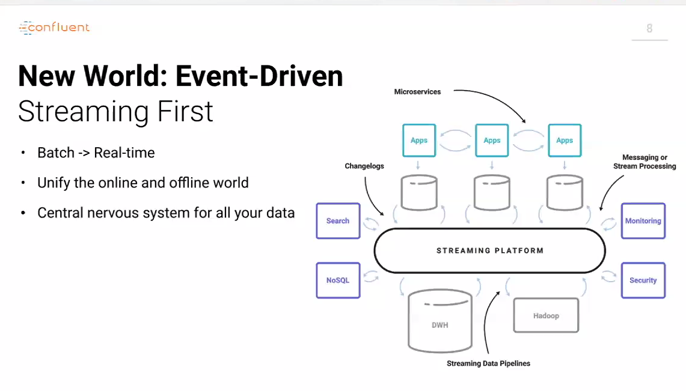

Slide 8
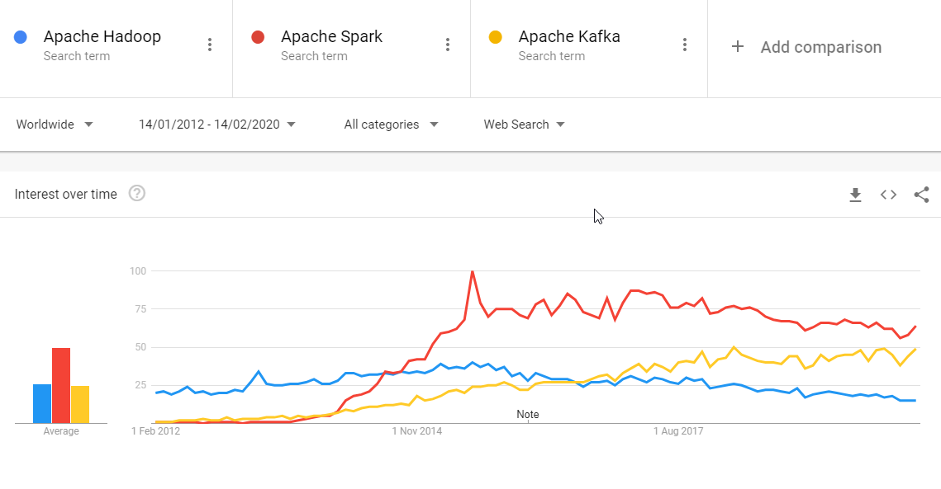
Notes:
https://trends.google.com/trends/explore?date=2012-01-14%202020-02-14&q=Apache%20Hadoop,Apache%20Spark,Apache%20Kafka

Slide 9
Cloud
Allowed to be conservative in investments.
Crawl before you walk and walk before you run.
Elasticity both for Storage and Processing.

Slide 10
Cloud services
Storage – HDFS –>Azure Data Lake...
Processing – Map Reduce –> Azure Kubernetes cluster, –> Azure Synapse Analytics, –> Azure Databricks...
Resources elasticity -> Create as you go via Automation scripts in PowerShell, Ansible.
Notes:
That too Azure Synapse Analytics take care of resource computation by itself “server as service”.

Slide 11
Azure Synapse Analytics
Simplifies your data lake and data warehousing solutions – Datalakehouse.
Reduces project development time for machine learning, BI, and AI.

Slide 12
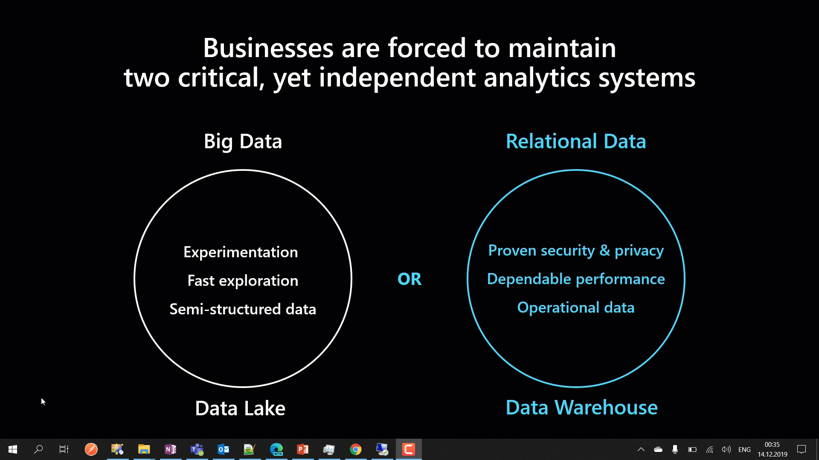
Notes:
Synapse Analytics combines Big Data and Relational Data to combine as one.

Slide 13
SQL Server Big Data Clusters

Slide 14
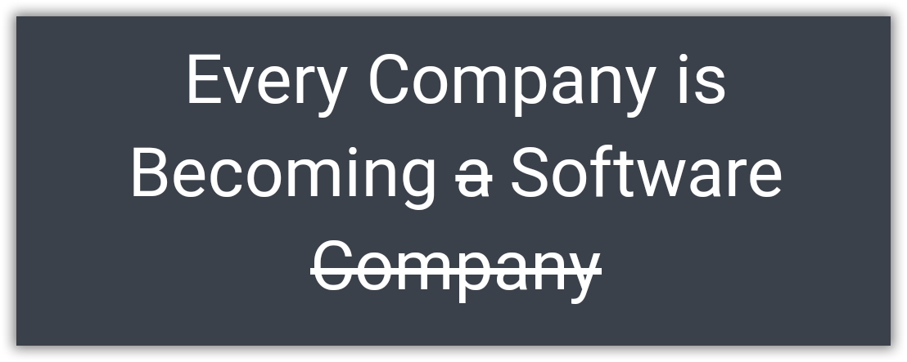
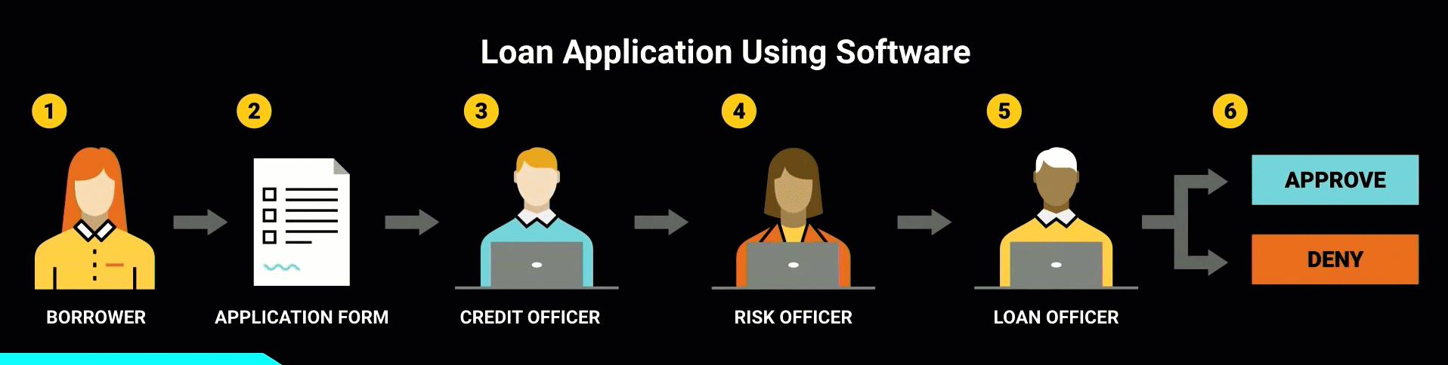
Borrowed from - https://www.youtube.com/watch?v=4QoCbhsQeyE
Notes:
Nowadays, a bank itself is software and takes the decision. Same case earlier humans took decisions using that software. A perfect example would be of sanctioning a personal loan. Things like the CIBIL score, a person’s authenticity available as up-to-date data has provided the power to decide to sanction a loan to machines themselves. Earlier, 1 or more bank employees should do the entire work of analyzing all these.
Finally I would like to end with this quote from Confluent.IO. “Every Company is Becoming software, which were previously just Using the software.”

Slide 15
Role of Data Engineer
Which raw data to use? - Almost all.
What kind of environment should I setup? – More of Big Data Admin.
How raw data be processed to create prepared data? – Big Data Developer.
Identify Combinations of prepared data and machine learning algorithms should you use to create the best model? – Data Scientist.
All these analysis as dashboard / report for decision making. – BI specialist.

Slide 16
ML.Net
Open source cross-platform machine learning framework.
Custom ML made like a play with AutoML – GUI.
Not required much expertise in ML.

Slide 17
Resources

Slide 18
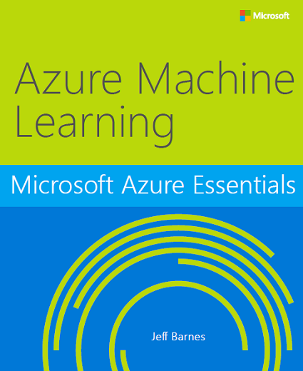
Free e-Book
http://bit.ly/a4r-mlbook
Notes:
Good book -- and free! Another recommended book on Azure Machine is Learning is "Predictive Analytics with Microsoft Azure Machine Learning " (https://www.amazon.com/Predictive-Analytics-Microsoft-Machine-Learning/dp/1484212010).

